Slide 1
AI/ML Guardrails for EEG Diagnosis
National Society of Black Engineers
AI Impact-a-thon
Team: The GMLG Legion
Ezra Olagoke
Daniel Anorue
Adeboye Adenuga
Imole Michael Oyetibo
Gabriel Kiveu
Marius Keita

Slide 2

What are AI/ML Guardrails?
AL/ML Guardrails are a set of rules or governance designed to ensure that the output of a Large Language Model (LLM) is safe, unharmful, ethical, and appropriate.
Essential for creating responsible and trustworthy AI systems.

Slide 3
Types of AI/ML Guardrails
Topical Guardrails
Ensuring the AI stays on a specific topic.
Security Guardrails
Preventing the AI from executing harmful code or interacting with malicious actors.
Bias and Fairness Guardrails
Detecting and mitigating biases in the AI's responses.
Multi-LLM Voting
Using multiple AI models to generate responses and then having a "judge" model select the best and safest one.

Slide 4
MISDIAGNOSIS OF EPILEPSY
Epilepsy is frequently misdiagnosed
Occurs most when non-epileptic events appear identical to seizures.
Sleep disorders, migraines, fainting, and psychogenic non-epileptic seizures (PNES) are often mistaken for epilepsy.
Between 20% to 30% of patients diagnosed don’t actually have epilepsy.
AI has also misdiagnosed epilepsy.

Slide 5
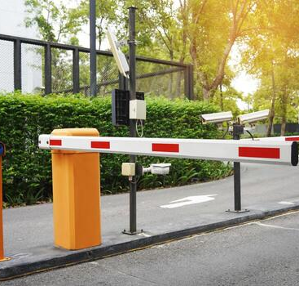
BARRIERS DUE TO MISDIAGNOSIS
Unjustified driving restrictions
Unnecessary anti-seizure medications
Psychological distress
Social stigma

